Slide 1

PBL5: Design Evolution
Ritsumeikan University
Intelligent Computer Entertainment Lab.
College of Information Science & Engineering
DareFightingICE Sound Design Competition 2025
PPT Progress 1
Andifallih Noor Malela, Liu Zhuorong
Fri, May 15th 2025
1

Slide 2
TABLE
OF CONTENTS
I
DareFightingICE
II
Main Strategy
III
Current Implementations
IV
Video Demo
2

Slide 3
I. DareFightingICE
DareFightingICE Sound Design Competition
Main Purpose: give hints to the production of sound designs that can be used in video games to improve their accessibility by Visually Impaired Players (VI players).
FightingICE with “Dare”: The platform of DareFightingICE simulates the VI player’s accessibility problem by using only sound as input.
Sound Design Evaluation:
Pre-screening: Survey for general respondents. Top 5 designs.
Screening: Blindfolded players play against the weak AI. Trained Blind AI with each Sound design.
3
Notes:
2D floor plans and even 3D models on monitors had limitations, especially for people who are not used to interpreting these technical visuals.
VR overcomes this by creating a fully immersive experience, which ca support deeper understanding of space, layout, and design, which helps both architects and clients identify design flaws early.
VR’s ability to support collaborative decision-making can be valuable in large projects, potentially reducing costs by catching issues that might only be found in the construction phase.

Slide 4
II. Main Strategy
Main Design Strategies
Game Interaction Model (Bei Yuan, 2010)
Player
Game
Start Game
VI Players is Unable to percieve primary stimuli (Visuals) from game
Changing primary stimuli from visuals to audio
Stimuli
Response
Until game over or finish
Audio Cues: use real world sounds to provide information or hints to the players
Sonification: uses non-speech audio to convey information using changes in pitch, amplitude or tempo.
Realism: improve sense of immersion while gaming
4
Notes:
2D floor plans and even 3D models on monitors had limitations, especially for people who are not used to interpreting these technical visuals.
VR overcomes this by creating a fully immersive experience, which ca support deeper understanding of space, layout, and design, which helps both architects and clients identify design flaws early.
VR’s ability to support collaborative decision-making can be valuable in large projects, potentially reducing costs by catching issues that might only be found in the construction phase.

Slide 5
III. Current Implementations
Changes & Addition So Far
All text-to-audio AI generated except for BGM which was a CC0 taken from OpenGameArt.org
BGM: Added for aesthetics aspect.
Timer countdown: Cue for last 5 seconds. Audio cue to indicate round is ending.
Enemy side location: Cue for when the enemy switched to left or right side of player.
Health cue: Heartbeat audio when reaching 200 HP (full HP = 400) and beeping audio when reaching 50 HP. More audio cue for player to monitor their health. https://youtu.be/OTyMksc974c
5
Notes:
2D floor plans and even 3D models on monitors had limitations, especially for people who are not used to interpreting these technical visuals.
VR overcomes this by creating a fully immersive experience, which ca support deeper understanding of space, layout, and design, which helps both architects and clients identify design flaws early.
VR’s ability to support collaborative decision-making can be valuable in large projects, potentially reducing costs by catching issues that might only be found in the construction phase.

Slide 6
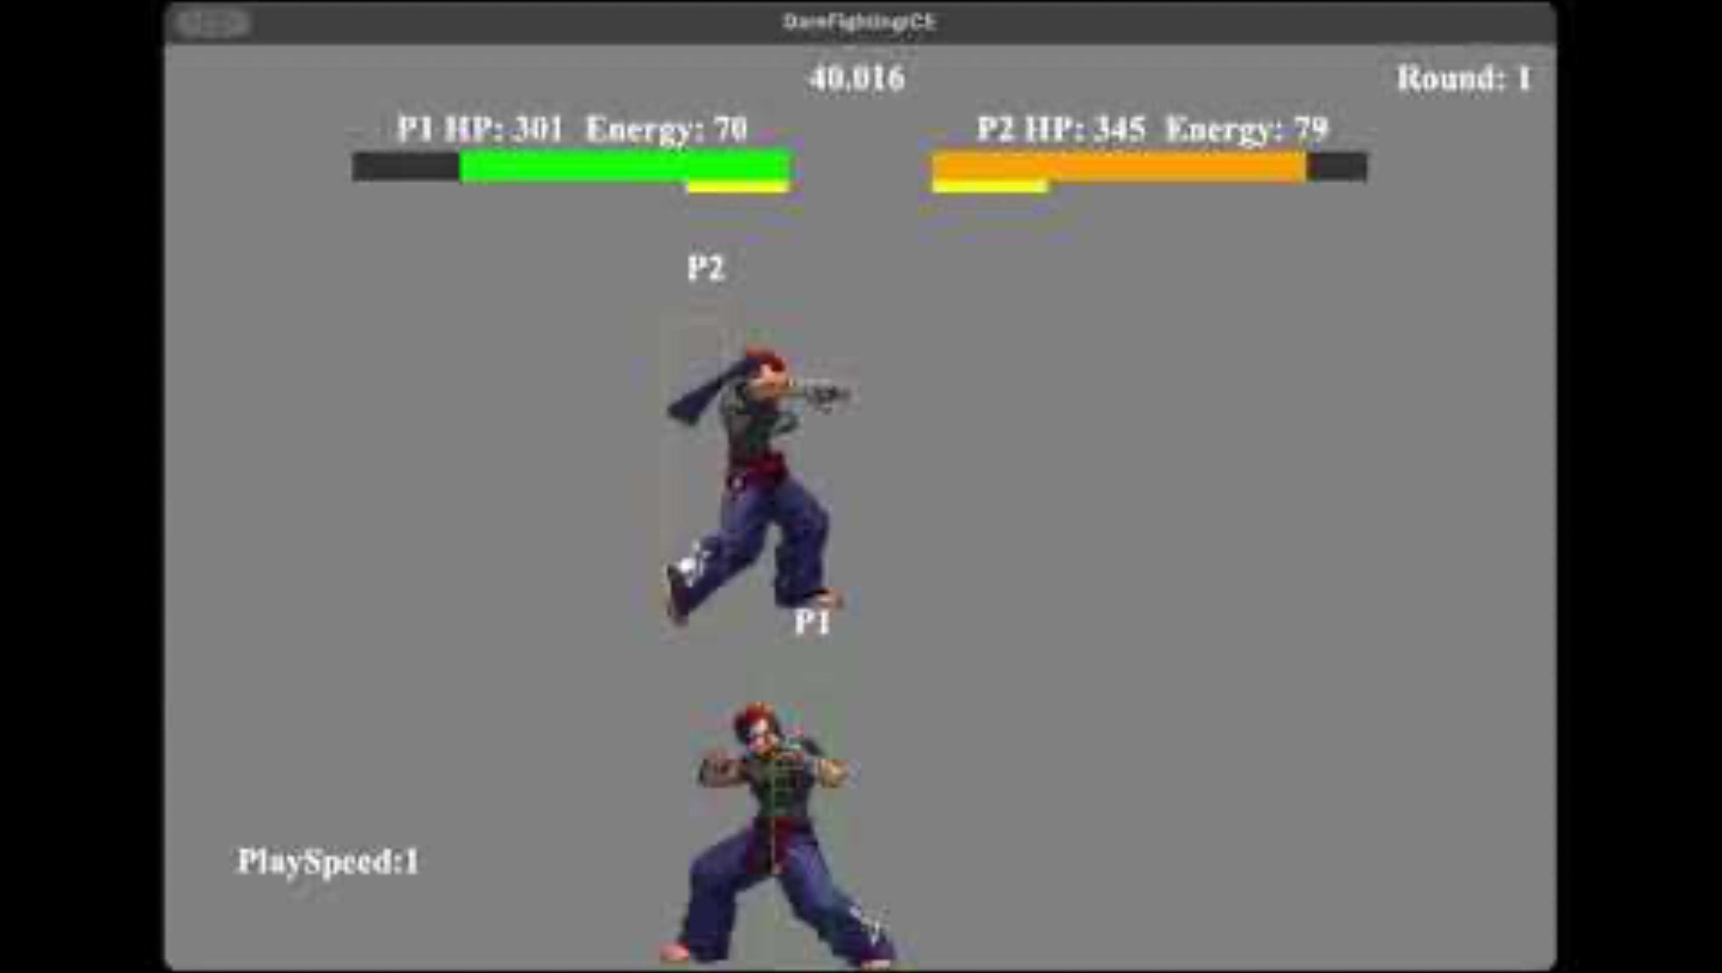
IV. Video Demo
6
Persistent link: https://youtu.be/OTyMksc974c
Notes:
2D floor plans and even 3D models on monitors had limitations, especially for people who are not used to interpreting these technical visuals.
VR overcomes this by creating a fully immersive experience, which ca support deeper understanding of space, layout, and design, which helps both architects and clients identify design flaws early.
VR’s ability to support collaborative decision-making can be valuable in large projects, potentially reducing costs by catching issues that might only be found in the construction phase.

Slide 7
References
Agrimi, E., Battaglini, C., Bottari, D., Gnecco, G., & Leporini, B. (2024). Game accessibility for visually impaired people: a review. Soft Computing, 28(17), 10475-10489.
Khan, I., Van Nguyen, T., Dai, X., & Thawonmas, R. (2022, August). Darefightingice competition: A fighting game sound design and ai competition. In 2022 IEEE Conference on Games (CoG) (pp. 478-485). IEEE.
Yuan, B., Folmer, E., & Harris, F. C. (2011). Game accessibility: a survey. Universal Access in the information Society, 10, 81-100.
9
Notes:
2D floor plans and even 3D models on monitors had limitations, especially for people who are not used to interpreting these technical visuals.
VR overcomes this by creating a fully immersive experience, which ca support deeper understanding of space, layout, and design, which helps both architects and clients identify design flaws early.
VR’s ability to support collaborative decision-making can be valuable in large projects, potentially reducing costs by catching issues that might only be found in the construction phase.

